Slide 1
OIL SPILL DETECTION SYSTEM with synthetic data generation pipeline and dynamic perceiver architecture
Presentation SLIDES
PROJECT GROUP – 20
SWETA PATTNAIK – A0296537M

Slide 2
INTRODUCTION
Oil spill detection system is useful for early detection and timely deployment of the oil spill services, which in turn, will help prevent damage to coastline, and other economic and social impact.
Causes of oil spill :
Accidents – Collisions, Allisions
Oil rigs
Industries waste
Deliberate oil spill or illegal discharge before entering the port
Naturally occurring oil spills – clues for oil prospects in deep sea / ocean profiling
In Singapore, the maritime traffic is one of the highest in the world. Cases of oil spill can happen any time (oil spill incident in West Coast, Singapore, around June, 2024.)

Slide 3
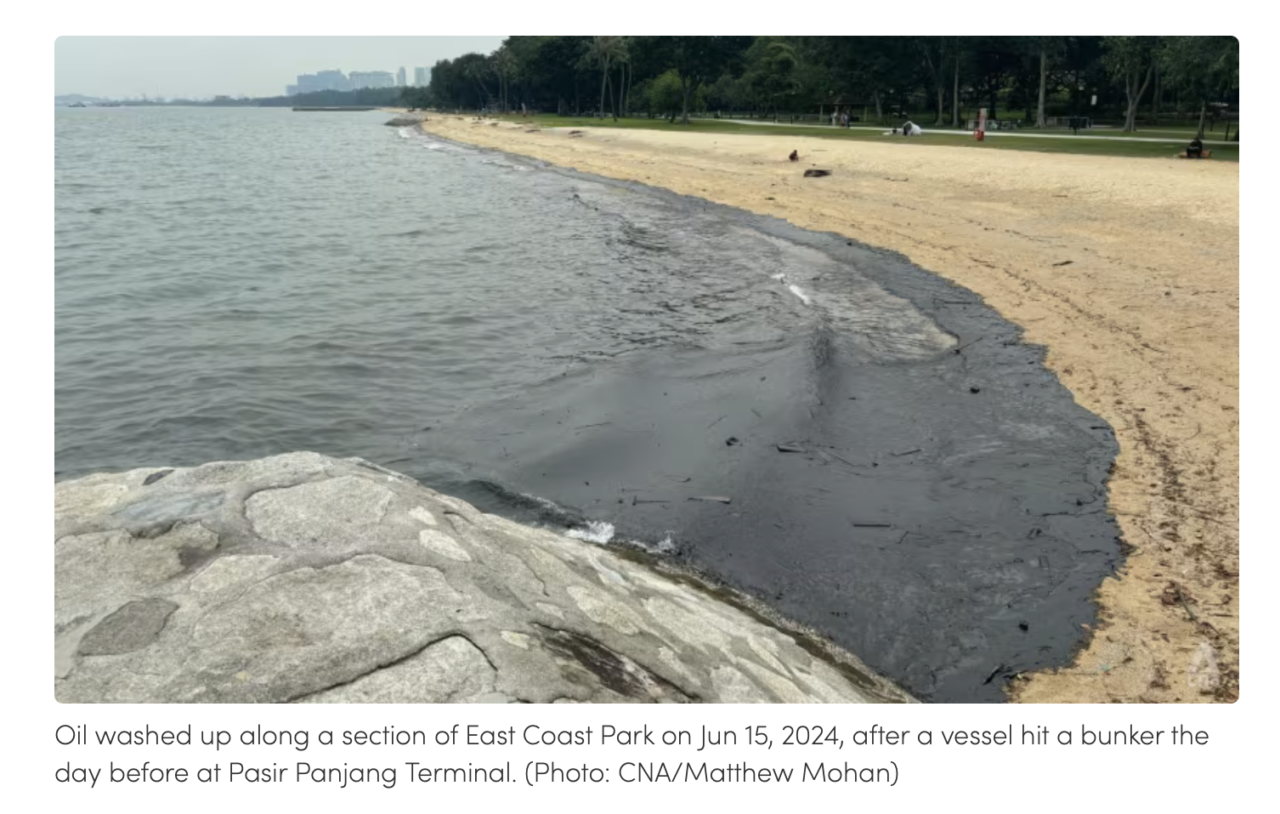
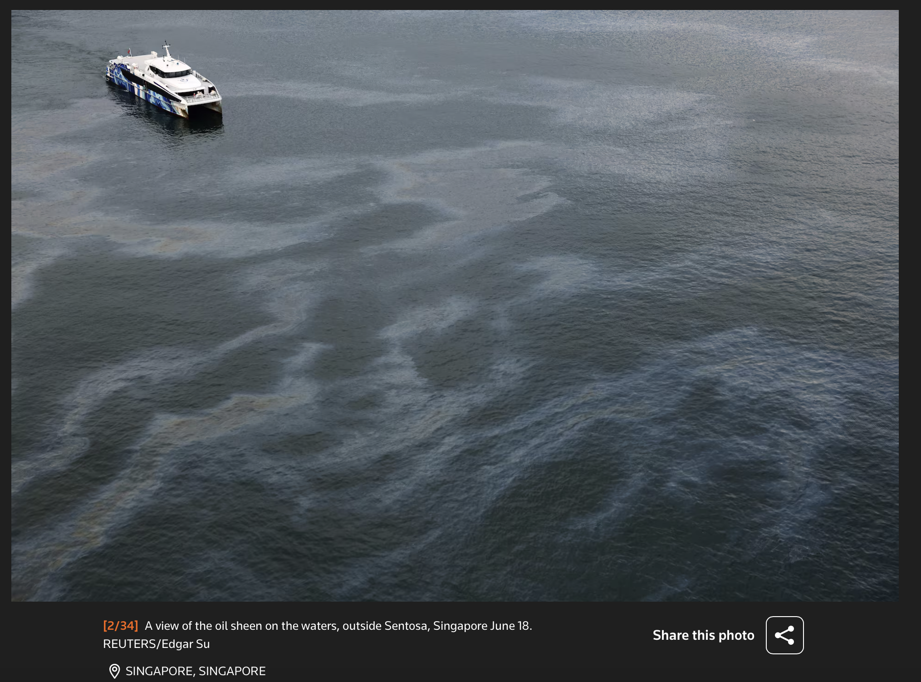
EXAMPLES
https://www.channelnewsasia.com/singapore/oil-spill-slick-sentosa-beaches-east-coast-park-labrador-park-4412481
https://www.reuters.com/pictures/pictures-singapore-intensifies-clean-up-oil-spill-spreads-along-coast-2024-06-17/

Slide 4
PROBLEM SCENARIO
Detection of oil spill incidents using SAR images along with the synthetic generated SAR images.
SAR :
One of the remote sensing modalities, measures the reflected backscatter of the microwave signals from the earth’s surface
Advantages:
Data acquisition in all weather and light conditions
No occlusion issue due to clouds
Use of dynamic perceiver architecture for efficient detection
Goals :
To get accuracy more than 90%, better than existing state of the art product
Use of synthetic SAR data along with original SAR data
Efficient detection with less false positives
Faster inference

Slide 5
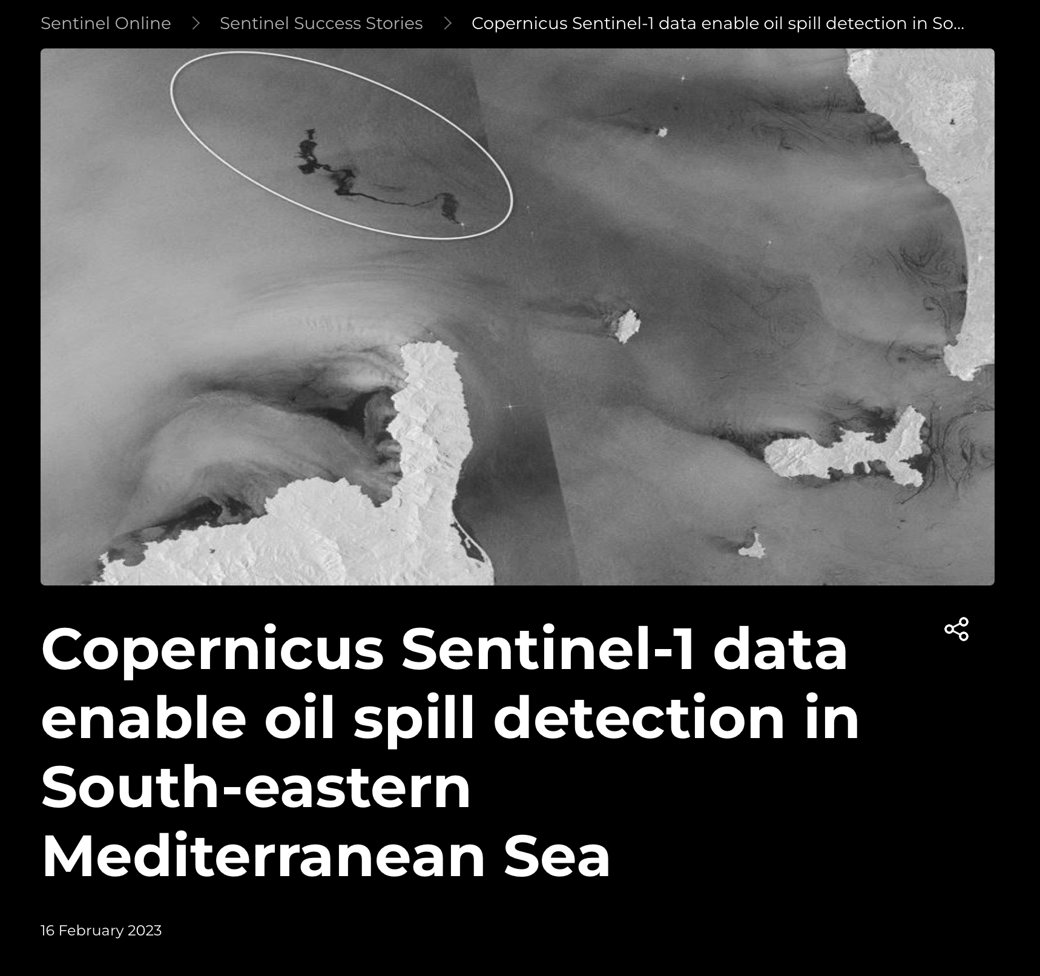
SAR FOR OIL SPILL DETECTION
The detector is based on the You Only Look Once version 4 (YOLOv4) object detection architecture, which was trained with 5930 Copernicus Sentinel-1 SAR images from 2015 to 2018. A total of 9768 oil spills from different sources and with varying sizes were discovered in the data and manually inspected by the researchers.
https://sentinels.copernicus.eu/web/success-stories/-/copernicus-sentinel-1-data-enable-oil-spill-detection-in-south-eastern-mediterranean-sea

Slide 6
COMMERCIAL SOLUTIONS
Company | Description | Technology | Link
Marine Aware | Enhanced modelling for maritime incidents and oil spills based in UK | Stochastic and physics modelling | https://www.riskaware.co.uk/what-we-do/marineaware/
OSRL | Service provider for oil spill related incidents | Oil spill modelling using Stochastic techniques | https://www.oilspillresponse.com/services/preparedness-services/consultancy/oil-spill-modelling/
Ocean Twin EU | Oil spill detection ad forecast system in Europe | AI based system – Use of FCOS for object detection and Unet Model for Semantic Segmentation | https://envcrimes2024.esa.int/wp-content/uploads/2024/06/S4_05_125_Outmani-KS.pdf

Slide 7
LITERATURE SURVEY
Focus Areas | Paper Description | Date | Link
Existing Oil Spill Detection solutions | Deep Learning based automatic detection of offshore oil slicks using SAR data and contextual information | 13 April 2022 | https://arxiv.org/pdf/2204.06371
 | Large-scale detection and categorization of oil spills from SAR images with deep learning | 24 Jun 2020 | https://arxiv.org/pdf/2006.13575
 | Oil spill segmentation using deep Encoder – Decoder models | 2 May 2023 | https://arxiv.org/pdf/2305.01386
 | Deep Learning-Based Approaches for Oil Spill Detection: A Bibliometric Review of Research Trends and Challenges | 12 July 2023 | https://www.mdpi.com/2077-1312/11/7/1406
 | Compositional Oil Spill Detection Based on Object Detector and Adapted Segment Anything Model from SAR Images | 15 Jan 2024 | https://arxiv.org/pdf/2401.07502v1
Synthetic SAR image generation | SAR Image Synthesis with Diffusion Models | 13 May 2024 | https://arxiv.org/pdf/2405.07776v1
 | DAKD : Data Augmentation and Knowledge Distillation using diffusion models for SAR Oil Spill Segmentation | 11 Dec 2024 | https://arxiv.org/pdf/2412.08116
Conditional Computation – Efficient Neural Networks principles | A Survey on Dynamic Neural Networks: From Computer Vision to Multi-Modal Sensor Fusion | 13 Jan 2025 | https://arxiv.org/pdf/2501.07451
 | Scardapane, S. et al., 2024. Conditional computation in neural networks: principles and research trends. Intelligenza Artificiale, in press, pp. 1-16. | 2024 | https://arxiv.org/pdf/2403.07965v2
Dynamic Perceiver | Dynamic Perceiver for Efficient Visual Recognition. Code : https://www.github.com/LeapLabTHU/Dynamic_Perceiver | 2023 | https://doi.org/10.1109/ICCV51070.2023.00551

Slide 8
DRAWBACKS IN EXISTING SOLUTION
Max accuracy is only around 80 percent (as per few CNN based solutions mentioned in the literature survey)
High false positive due to misclassification of non oil spill images.
Inference latency is high
Challenges in ease of deployment
Dataset challenges :
The acquisition of SAR images with oil spill events is very low.
Ground truth labeled images are scarce and costly, need human experts to label which takes hours just to label one image.

Slide 9
PROPOSED SOLUTION
Detection of oil spill incidents using SAR images along with the synthetic generated SAR images with cDDPM.
Use of dynamic perceiver architecture for efficient detection.

Slide 10
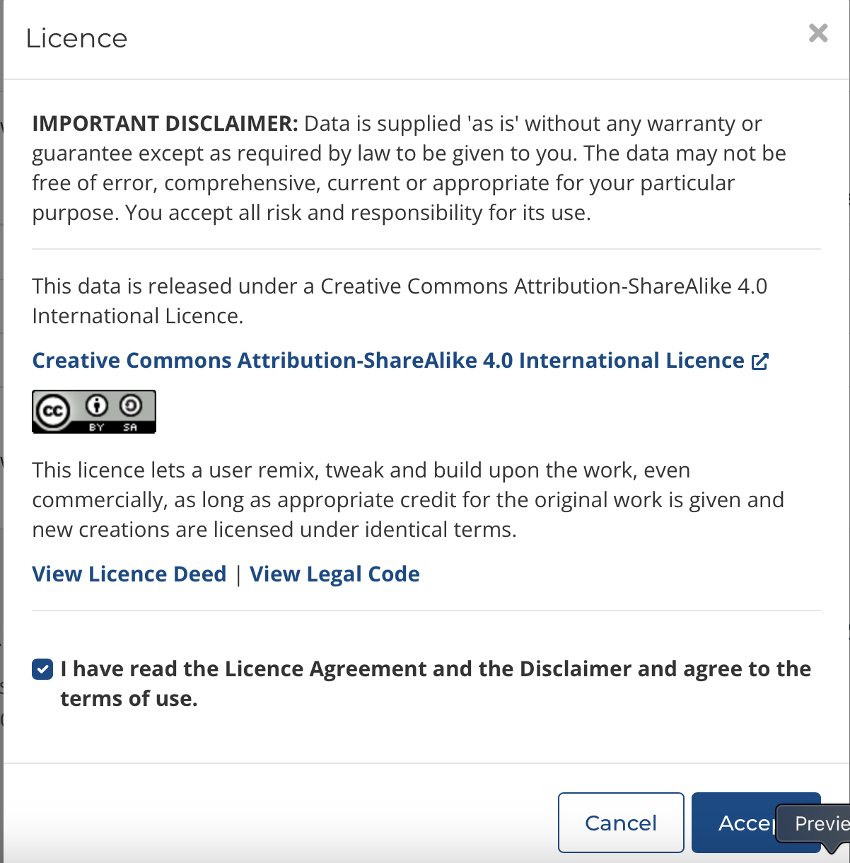
DATASET COLLECTION
https://doi.org/10.25919/4v55-dn16 - CSIRO Sentinel-1 SAR image dataset of oil- and non-oil features for machine learning ( Deep Learning )
Blondeau-Patissier, David; Schroeder, Thomas; Diakogiannis, Foivos; & Li, Zhibin (2022): CSIRO Sentinel-1 SAR image dataset of oil- and non-oil features for machine learning ( Deep Learning ). v1. CSIRO. Data Collection. https://doi.org/10.25919/4v55-dn16
License :

Slide 11

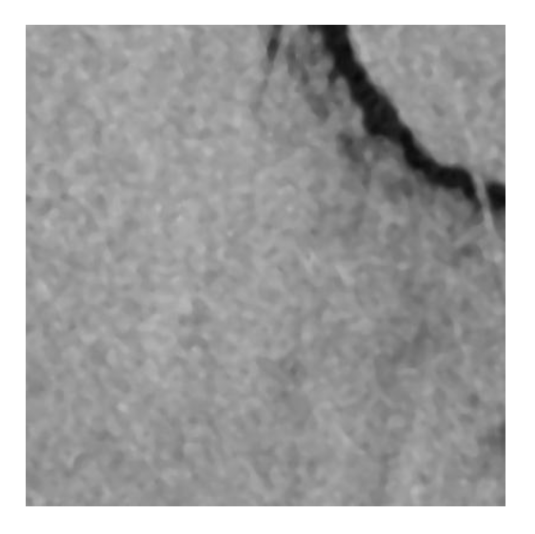
ORIGINAL DATASET
Class Label | Number of Samples
0 : Non-Oil Spill | 3725
1 : Oil Spill | 1905
Total Samples | 5630
Label 0 sample
Label 1 sample

Slide 12
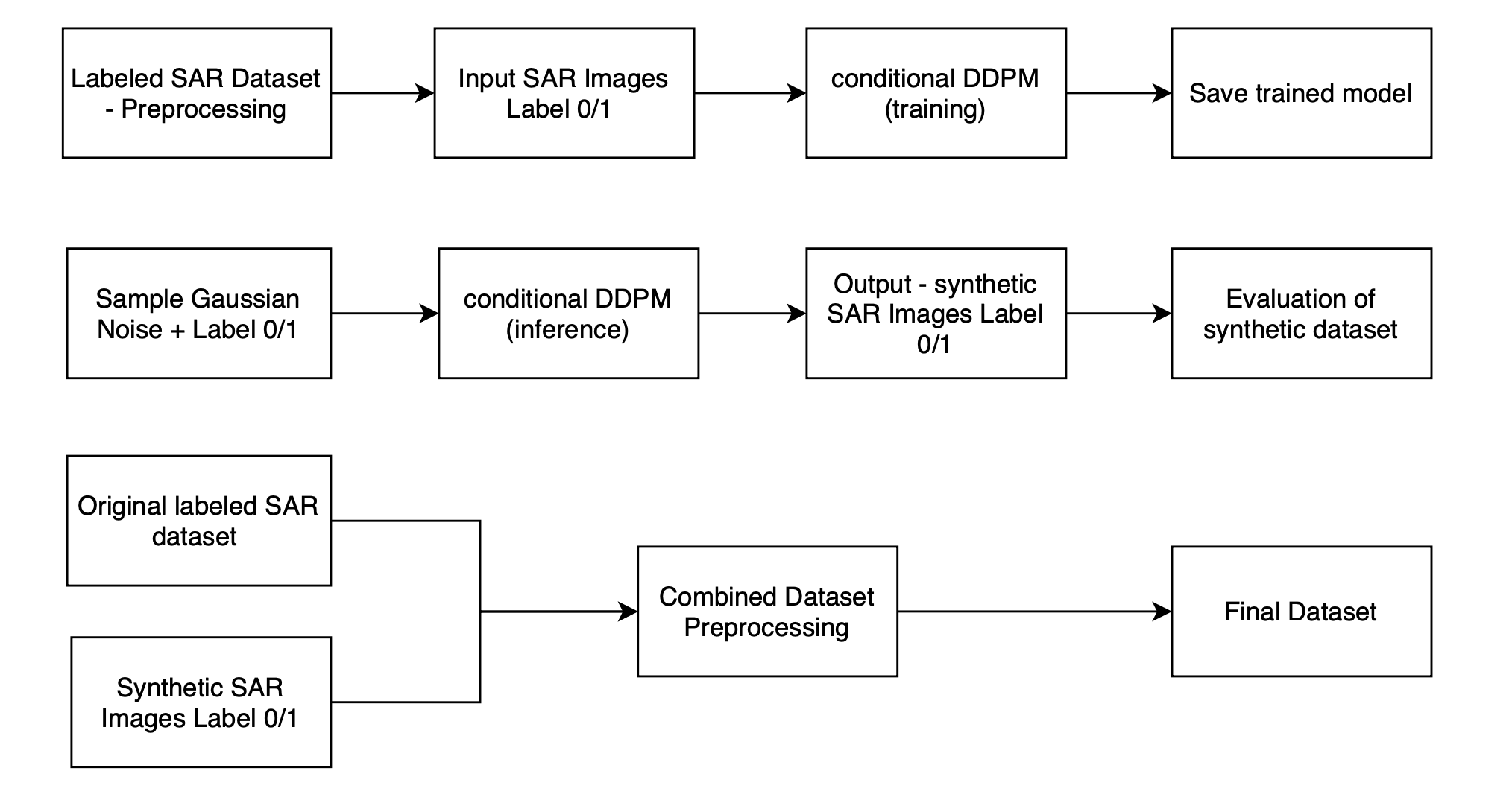
DATASET PIPELINE
Reference paper - SAR Image Synthesis with Diffusion Models - https://arxiv.org/pdf/2405.07776v1
this paper already evaluates the performance of DDPM and various GAN models.
DDPM perform better, so in the project DDPM to be used for synthetic data generation.
Evaluation of synthetic dataset with original SAR dataset to be done using FID – Fréchet Inception Distance metric

Slide 13
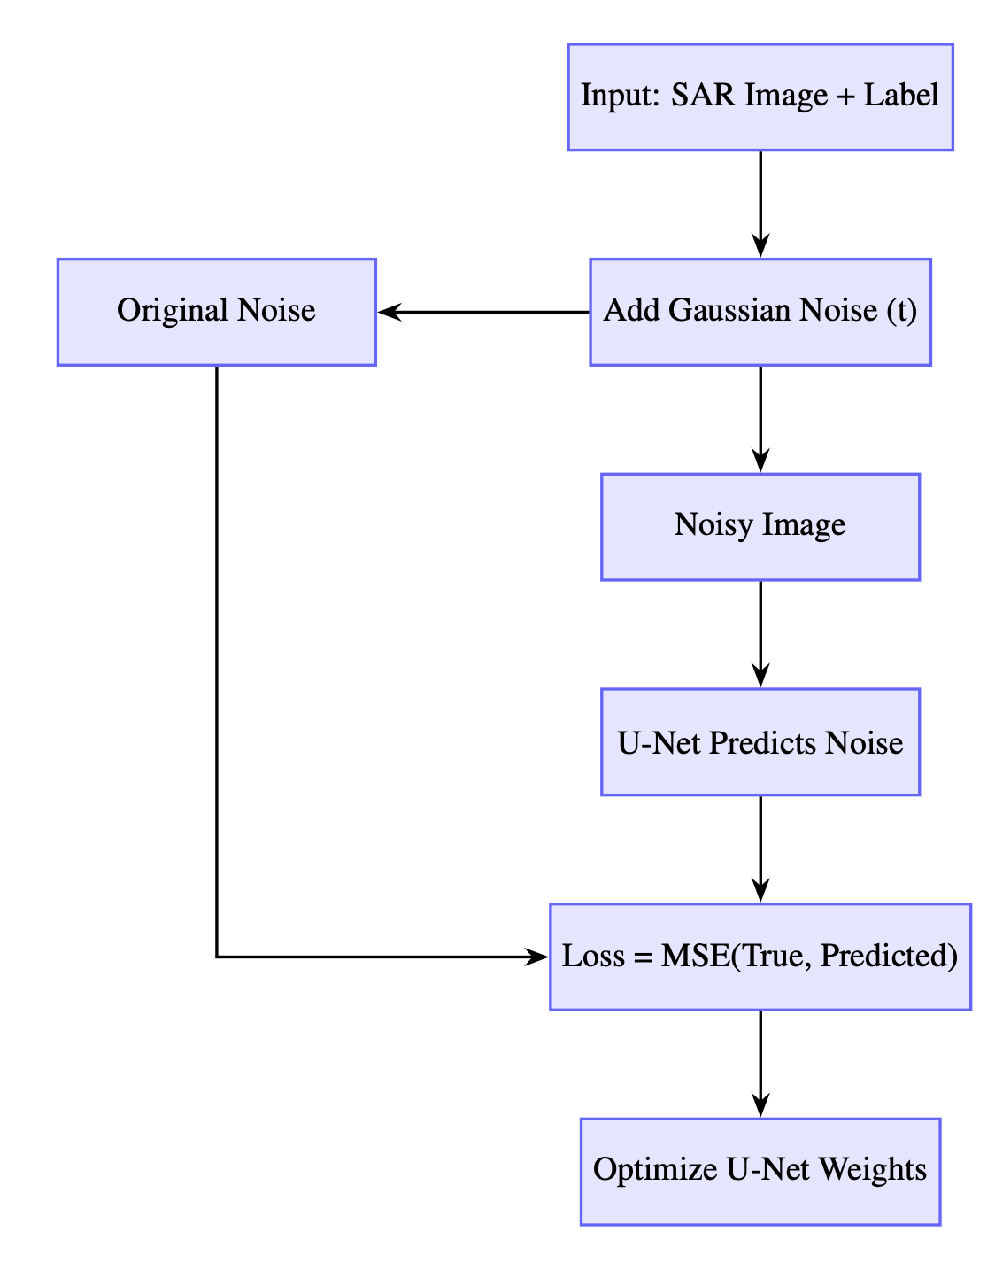
DATASET PIPELINE - FLOWCHART
TRAINING PIPELINE FOR THE SYNTHETIC DATASET GENERATION:
The core components:
Custom dataset loader
Conditional U-Net
Diffusion scheduler
Trainer module
Conditional U-Net:
Enhanced with residual blocks and skip connections
Class label embedded into a 128-dim vector and injected to guide denoising
Diffusion Scheduler:
Defines the noise schedule (beta)
Manages noise injection over 200 time steps
Training Process:
Adds Gaussian noise to SAR images at random steps
U-Net predicts the noise
Uses Mean Squared Error (MSE) loss
Weights updated via backpropagation
Trainer Functionality:
Supports saving, evaluation, and sample generation
Reverses noise steps to create synthetic SAR images conditioned on class

Slide 14
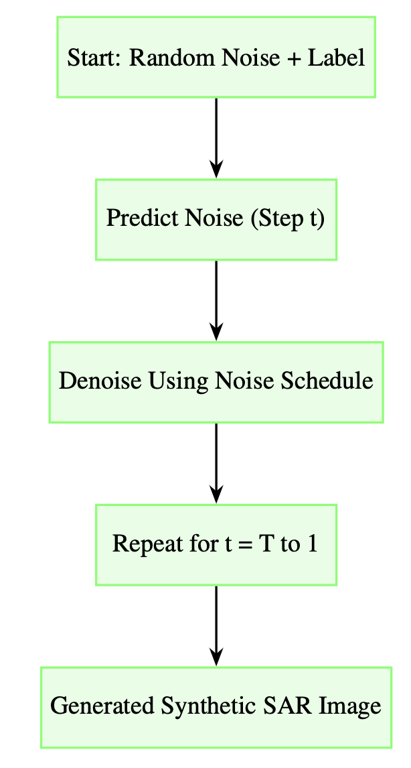
DATASET PIPELINE - FLOWCHART
INFERENCE PIPELINE FOR SYNTHETIC DATASET GENERATION :
Input:
Starts with random Gaussian noise and a target class label (oil / non-oil)
Step-wise Denoising:
At each timestep t, the trained U-Net predicts the noise present in the image
A noise scheduler uses this prediction to perform denoising
Iterative Process:
The denoising step is repeated from t = T down to 1
Output:
Final output is a fully denoised image — a synthetic SAR image resembling the target class

Slide 15
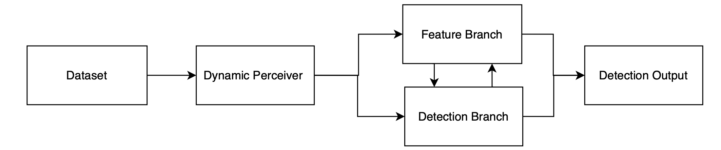
MODEL ARCHITECTURE
Dynamic Perceiver architecture - Dynamic Perceiver for Efficient Visual Recognition
Better than CNNs and ViTs in terms of accuracy and inference efficiency.
Adaptable and versatile framework
Reference Code https://www.github.com/LeapLabTHU/Dynamic_Perceiver

Slide 16
PROJECT DELIVERABLES
Original labelled SAR dataset, Synthetic SAR dataset using cDDPM, and combined datasets - their comparison and evaluation based on FID.
Model performance on original dataset, synthetic dataset and combined dataset.
A working oil spill detection system, web-based where users can upload SAR images and get the detection result.

Slide 17
COMPARISON OF DATASET LEVEL METRICS: FID SCORE AND DATASET UTILITY
DATASET TYPE | FID SCORE | SYNTHETIC UTILITY
ORIGINAL | NA | BASELINE (84.2 %)
SYNTHETIC | 21.4 | MODERATE (81.6 %)
COMBINED | 19.8 | HIGH (89.1 %)
The FID score is good which indicates that the generated images are realistic enough and can be used in the downstream tasks.

Slide 18
PERFORMANCE COMPARISON OF DYNAMIC PERCEIVER MODEL ON DIFFERENT DATASET TYPES
DATASET TYPE | ACCURACY | F1-SCORE | IoU
ORIGINAL | 84.2 | 0.83 | 0.74
SYNTHETIC | 81.6 | 0.79 | 0.70
COMBINED | 89.1 | 0.87 | 0.81
The key takeaway from here is that the combined dataset yields significantly better results across all evaluation metrics compared to training on either original or synthetic data alone.

Slide 19
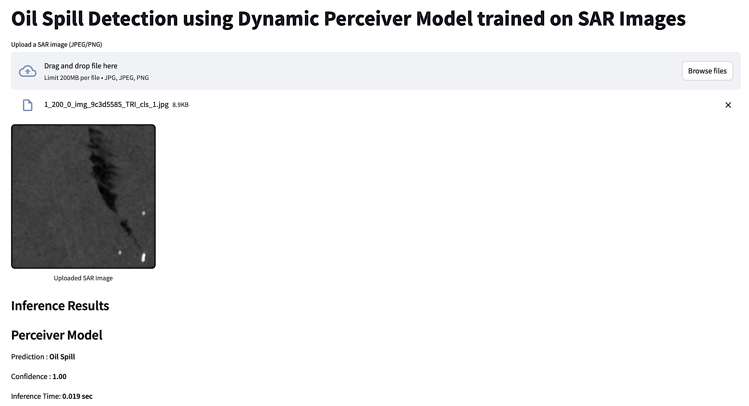
WEB BASED OIL SPILL DETECTION SYSTEM
A working oil spill detection system, web-based where users can upload SAR images and get the detection result.

Slide 20
CHALLENGES
Collection of labeled Oil Spill SAR dataset
Benchmarking synthetic dataset
Deployment considerations for edge devices – Faster inference, Low power, Conditional computation

Slide 21
CONCLUSION
Developed a comprehensive oil spill detection system using SAR imagery
Integrated synthetic data generation via class-conditional DDPM (cDDPM)
Designed a modular detection pipeline with the Dynamic Perceiver architecture
Outperformed traditional CNNs on accuracy, F1-score, and inference speed
Conducted a full evaluation across: Original, Synthetic, and Combined datasets
Reported metrics: FID, Precision, IoU

Slide 22
FUTURE SCOPE
Satellite images depend on the revisit frequency, like Sentinel-1 has 12 days revisit time.
Data from multiple sources like optical images from satellite, cameras, drones, UAVs, etc will be helpful.
Fine-tuning diffusion models on domain-specific SAR priors (for example - RTSAR image dataset) to improve realism and edge fidelity in synthetic samples.
Deploying the model on low-power edge devices (e.g., Hailo AI chips) and optimizing inference pipelines for real-time maritime surveillance.

